Slide 1
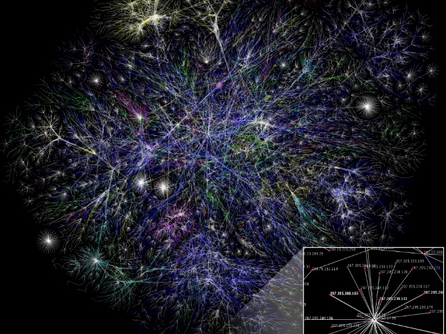
Wavelength Assignment
Chapters 5: J. M. Simmons,
Optical Network Design and Planning, Optical Networks,
© Springer International Publishing 2014

Slide 2
Introduction
Wavelength continuity: Connection that traverses a node
all-optically must enter and exit the node on the same
optical frequency.
Effective wavelength assignment (WA) strategies must be
utilized to ensure minimum wavelength contention.
WA is tightly coupled to the routing process, as the
selection of the route determines the links on which a free
wavelength must be found.
The two processes are often referred to RWA problem.
The presence of regeneration has a significant impact on
WA because it allows for a change in wavelength.

Slide 3
Introduction, cont’d
Network planning process:
Routing (Ch. 3) → Regeneration (Ch. 4)→ WA (Ch. 5)
No guarantee that the route found will be amenable to a feasible WA
Optimal approach
multistep Net. Planning approach
RWA as a single step Net. planning

Slide 4
Role of Regeneration in WA
If a demand is carried all-optically from source to
destination, then the same wavelength must be used on
all links of the path (assuming all-optical wavelength con-
version is not available).
Sub-connection refers
to the portions of a
connection that
fall between two
regeneration points or
between an end point
and a regeneration point.

Slide 5
Multistep RWA
A route is selected for a connection, then the connection is broken into
subconnections, if necessary, and each of the subconnections is assigned a
wavelength.
Minimizing the occurrence of wavelength contention requires good routing
strategies.
Alternative-path routing: one first generates a set of candidate paths for a
particular source/destination combination, where the candidate paths are
chosen to minimize cost and to provide good load balancing in the network.
As demands are added, the current state of the network is considered when
selecting one of the candidate paths to use for a particular demand request.
A good strategy is to select the least-loaded candidate path, such that the
minimum number of wavelengths that are free on each link of the selected path
is maximized.

Slide 6
Multistep RWA, cont’d
The multistep methodology of treating routing, regeneration, and wavelength assignment separately usually performs well in practice. When the network is very heavily loaded, wavelength contention may occur where subconnections are created for which there are no feasible wavelength assignments.
Four strategies for ameliorating and Alleviating Wavelength Contention are:
1- different regeneration sites for a connection potentially can be selected,
not incurany additional cost;

Slide 7
Multistep RWA, cont’d
2- In realistic networks, when wavelength assignment fails, it is typically because
of a small number of heavily loaded links. One may move some demands
away from these links.
The simplest means of achieving this is to pick a different candidate path for
some of the demands, where the originally selected path included one or
more “bad” links, and where the new path does not include any.
3- If not enough demands have candidate paths that avoid the bad links, then
one can make use of dynamic routing. The links that are causing the problems
in the wavelength assignment process can be temporarily eliminated from the
topology before calling the shortest-path algorithm.
4- One of the candidate paths can be selected and any residual wavelength
contention can be alleviated by adding in extra regeneration.
If the network is so full that wavelength contention is causing a great deal of extra regenerations to be added, then it is probably time to add additional capacity to the network.

Slide 8
One-step RWA
Various one-step RWA methodologies are available, all of which impose additional processing and/or memory burdens.
Under heavy load, using a one-step methodology can provide a small improvement in performance, and as the scarcity of free wavelengths should lead to lower complexity.
The four available one-step RWA techniques:
Topology Pruning
Reachability Graph Transformation
Flow-Based Methods
ILP-Based Ring RWA

Slide 9
Topology Pruning
One of the earliest advocated one-step algorithms starts with a particular wavelength and reduces the network topology to only those links on which this wavelength is available.
The routing algorithm (e.g., a shortest-path algorithm) is run on this pruned topology. If no path can be found, or the path is too circuitous, another
wavelength is chosen and the process run through again on the
correspondingly pruned topology.
The process is repeated with successive wavelengths until a suitable path is found.
With this combined approach, it is guaranteed that there will be a free wavelength on any route that is found. If a suitable path cannot be found after repeating the procedure for all of the wavelengths, the demand is blocked.
Overall, this strategy is less than ideal.

Slide 10
Reachability Graph Transformation
A more direct unified RWA approach is to create a transformed graph whenever
a new demand request arrives
In long-term planning, every network node appears in the transformed graph; in real-time planning, only nodes with available regeneration equipment, plus the source and the destination, are added to the transformed graph.

Slide 11
Flow-Based Methods
Global optimization techniques can be applied to the one-step RWA problem as well. Integer linear programming (ILP) approaches are generally not scalable for networks of practical size; however, linear programming (LP) techniques may be feasible.
Relaxing the integrality constraints enables more rapid convergence. Various perturbation and rounding techniques are applied to ultimately produce a (possibly nonoptimal) integer solution.
A cost function is used to encourage load balancing. Also, the cost function is input as a piecewise linear function with integer breakpoints as another means of pushing the LP towards an integer solution.

Slide 12
ILP-Based Ring RWA
Although ILP formulations have generally been considered too slow for practical RWA, a scalable ILP methodology has been proposed for ring topologies
Attempts to find a scalable ILP approach for ring RWA have been ongoing for almost two decades.
Please read the textbook for the introduced methods

Slide 13
Wavelength Assignment Strategies
First-Fit
Most-Used
Relative Capacity Loss
Qualitative Comparison

Slide 14
First-Fit
First-Fit is the simplest of these three wavelength
assignment schemes.
Each wavelength is assigned an index from 1 to W, where
W is the maximum number of wavelengths supported on a
fiber.
No correlation is required between the order in which a
wavelength appears in the spectrum and the assigned
index number.
The indices remain fixed as the network evolves.
Whenever wavelength assignment is needed, the search for
an available wavelength proceeds in an order from the
lowest index to the highest index. The first available
wavelength found is selected.

Slide 15
First-Fit

Slide 16
Most-Used
Most-Used, is more adaptive than First-Fit, although it requires more information.
Whenever a wavelength needs to be assigned, a wavelength order is established
based on the number of link-fibers on which each wavelength has already been
assigned.
The wavelength that has been assigned to the most link-fibers already is given
the lowest index, the wavelength that has been assigned to the second-most link-
fibers is given the second lowest index, etc.
After the wavelengths have been indexed, the assignment procedure proceeds
as in First-Fit.
The motivation behind this scheme is that a wavelength that has already been
assigned on a lot of fibers will be more difficult to use again.
Thus, if a scenario arises where a heavily used wavelength can be used,
it should be assigned.

Slide 17
Relative Capacity Loss
RCL is more complex than either of the previous schemes.
The idea is that wavelength assignment should take into account how much
“harm” it is doing to demands that may be added in the future; i.e., how likely
will it cause wavelength contention for future demands.
This scheme is more amenable to the multistep RWA process; thus, this is the
focus of the discussion.
The first step in RCL is to generate the set of possible paths in the network,
e.g., based on a traffic forecast. When regeneration is present in a network,
it is actually the set of possible subconnections that needs to be enumerated.
If some subconnections are expected to arise more than others, as is likely to be
the case, then the subconnections should be added to the list multiple times to
reflect their expected relative frequency.
This enumeration step is done prior to any traffic being added to the network,
although the list can be updated if necessary as the network evolves.

Slide 18
Relative Capacity Loss

Slide 19
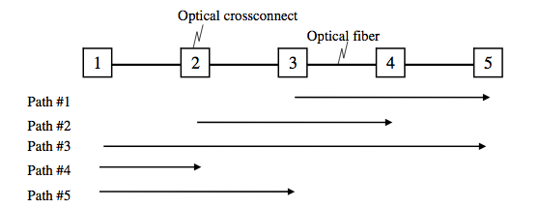
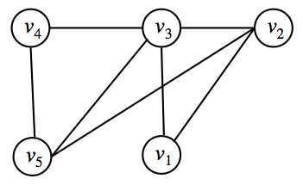
Wavelength Assignment (WA) Problem
Optical path requests
Heuristic method
???
Graph construction for coloring

Slide 20
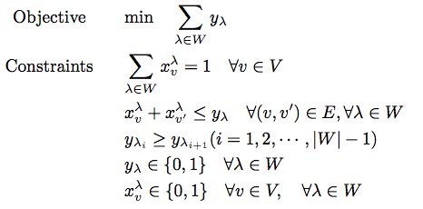
LP Formulation for Graph Coloring
Let $W$ be a set of $λ$, where $W = \{λ1,λ2,··· ,λ|W|\}$
Let $xλv$ and $yλ$, be binary variables. If λ is assigned to a path corresponding $v$, $xλv$ = 1, otherwise $xλv$ = 0.
If λ is used at least one time $yλ$=1, otherwise $yλ$ = 0.

Slide 21
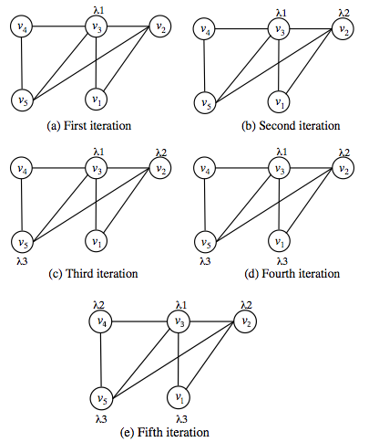
Heuristic: Largest Degree First (LDF)
Step 1: select the uncolored vertex with
largest degree.
Step 2: choose the min indexed color
from the colors that are not used by the
adjacent vertices.
Step 3: color the selected vertex using
the color chosen in step 2.
Step 4: if all vertices are colored, LDF
stops. otherwise, LDF returns to step 1.
Wavelength assignment process of LDF

Slide 22
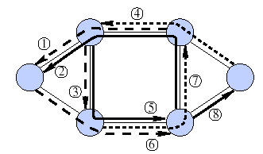
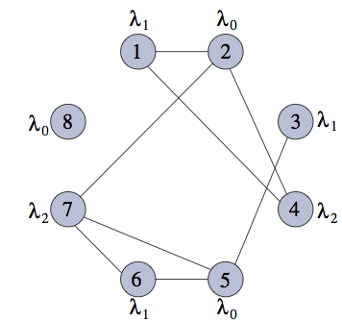
Another example: Graph Coloring Problem
Problem can be reduced to graph coloring
Construct a graph G where nodes represents lightpaths, an edge exists between two nodes if the corresponding lightpaths pass through a common physical link
Color the nodes in G such that no two adjacent nodes have the same color
2
3
1
4
6
5
Network with eight routed-lightpaths
Auxiliary graph for the
lightpaths in the network

